Slide 1


Getting started
Notes:
Why choosing SOFA (again)
Training & support : InriaAcademy / YouTube / Documentation / GitHub Discussions / Chat / Get-involved
How to collaborate: research teams, companies, join the Consortium
Upcoming events

Slide 2
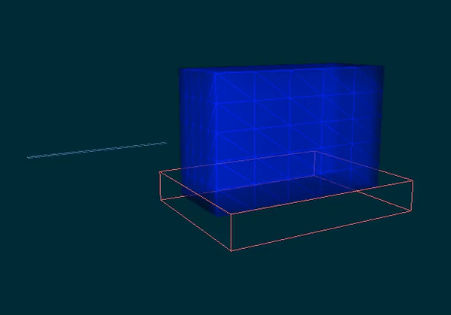
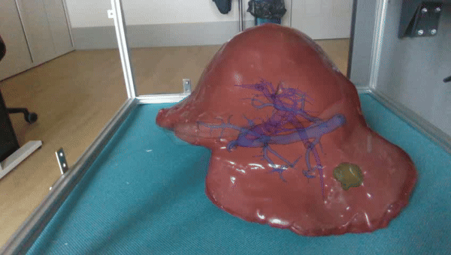
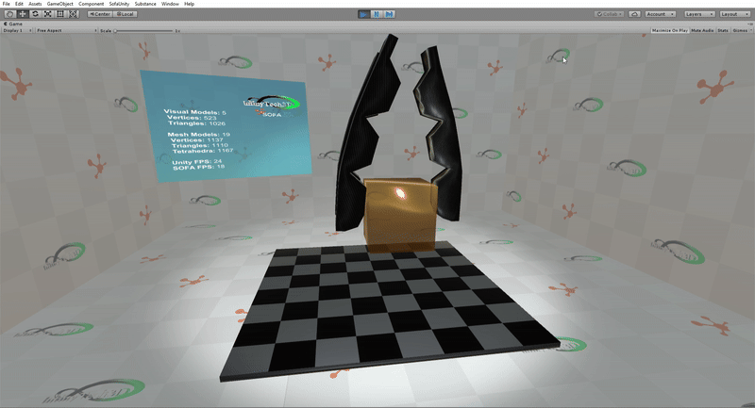
Why choosing SOFA?
Flexible
Ease design and prototyping of simulation
Modular architecture
OpenCore with plugins: activate / deactivate features
Interactive
User interactions to take into account
Enclose SOFA in optimization loops, learning
Dynamic simulation updates

Slide 3
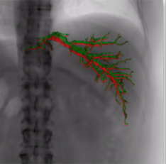
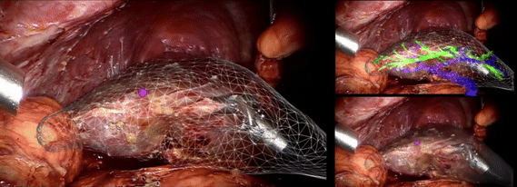
Applications in medicine
For medical training
Surgical gesture training, avoiding the 1st gesture on a patient
Force feedback
Predict and propose optimal surgical strategies
Optimize strategies (trajectory, entry point, device)
Optimize medical devices → patient-specific
Guide during surgery
Visualize sensitive structures
Help navigating, keeping a target in sight

Slide 4

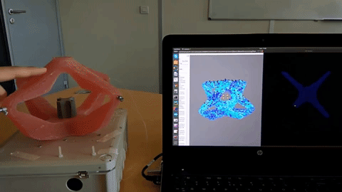
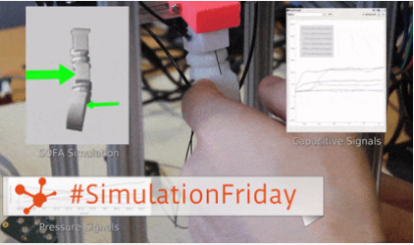
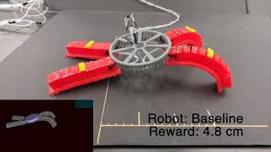
Applications in (soft)robotics
Modeling a deformable robot or its deformable environment
Design a new generation of soft-robots, closing the Sim2Real gap
Assess new control laws, possibly learning/AI-based

Slide 5
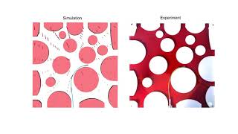
Applications in (soft)robotics
Actuators
Pneumatic where the pressure of the chamber can be controlled
Fluidic where the volume of the chamber can be controlled
Tendon or a cable
Electromagnetic (proof of concept by ETH)
Performance: model-order reduction, MT, GPU
Learning from simulations
SofaGym: Reinforcement Learning - Open AI
DeepPhysX: Deep Neural Network - pytorch

Slide 6


Go further with SOFA
Learn SOFA
Courses through the InriaAcademy program → inria-academy.fr
Free online introduction course on YouTube (doc)
Get support
Online documentation → sofa-framework.org/doc
Forum : GitHub Discussions → github.com/sofa-framework/sofa/discussions
Chat on Discord with developers → discord.gg/G63t3a8Ra6
All information → sofa-framework.org/community/get-involved

Slide 7
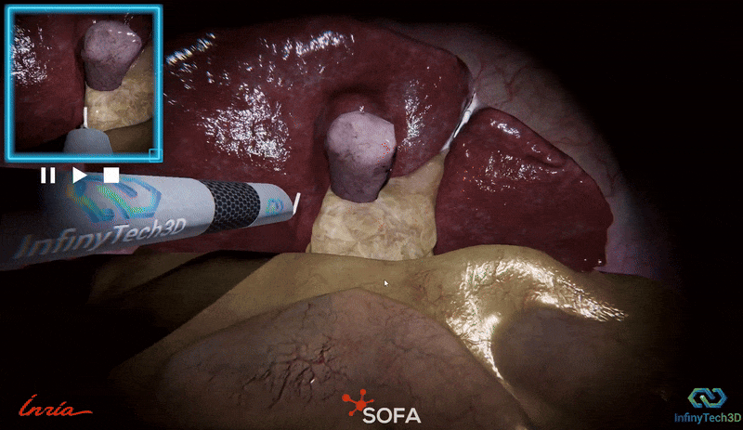


Let’s collaborate
Worldwide academic community
CIFRE
Bilateral partnership
EU project proposals
Bilateral partnership with companies
Consulting
Product co-development
Become a SOFA Consortium member

Slide 8
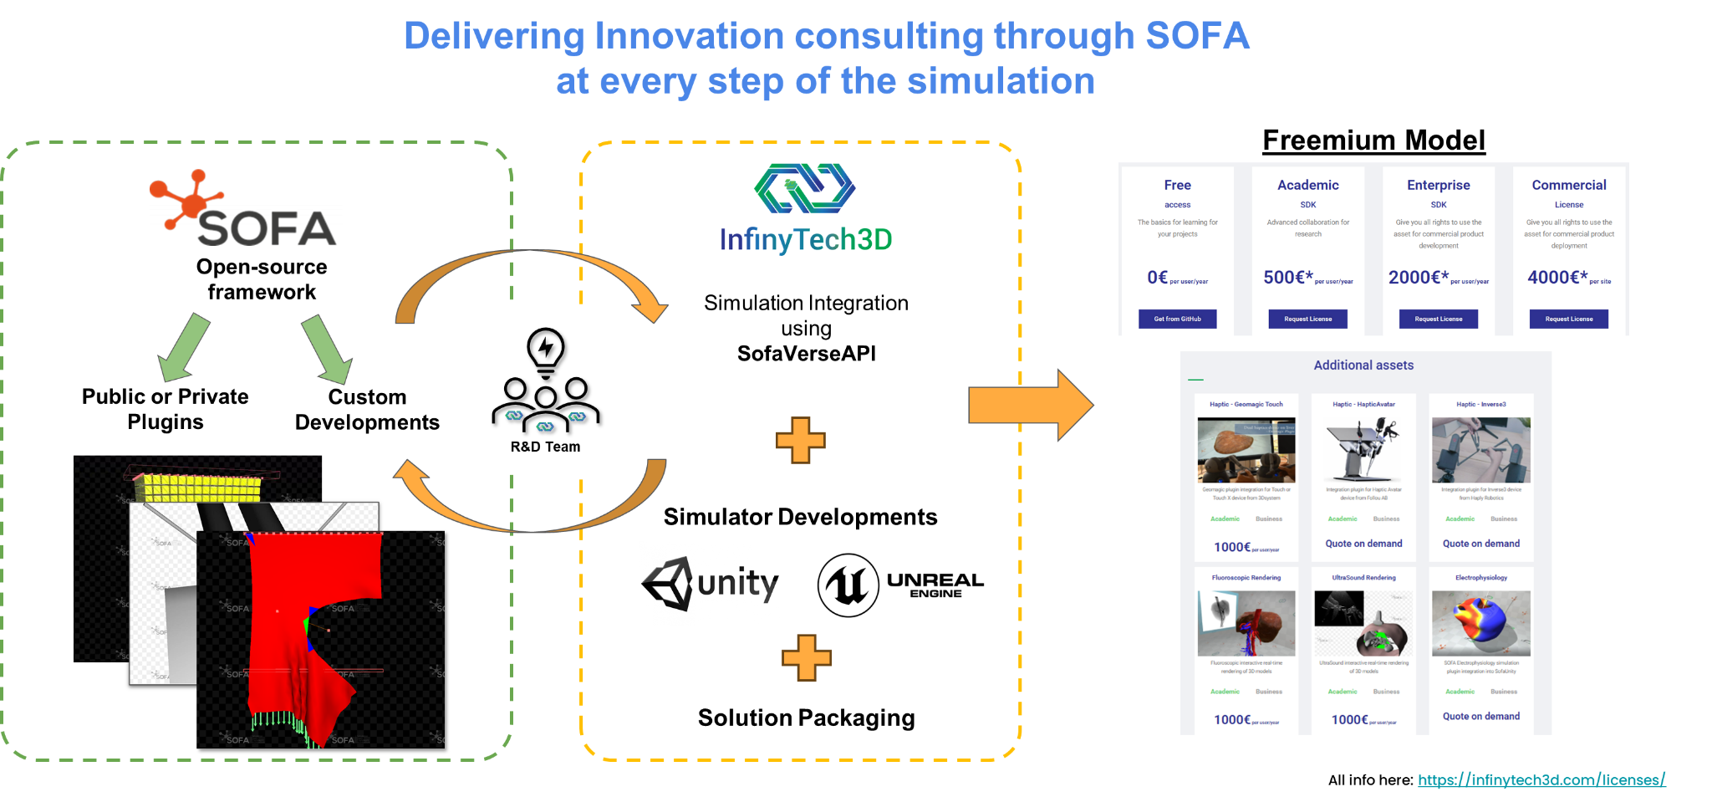
InfinyTech3D Model

Slide 9
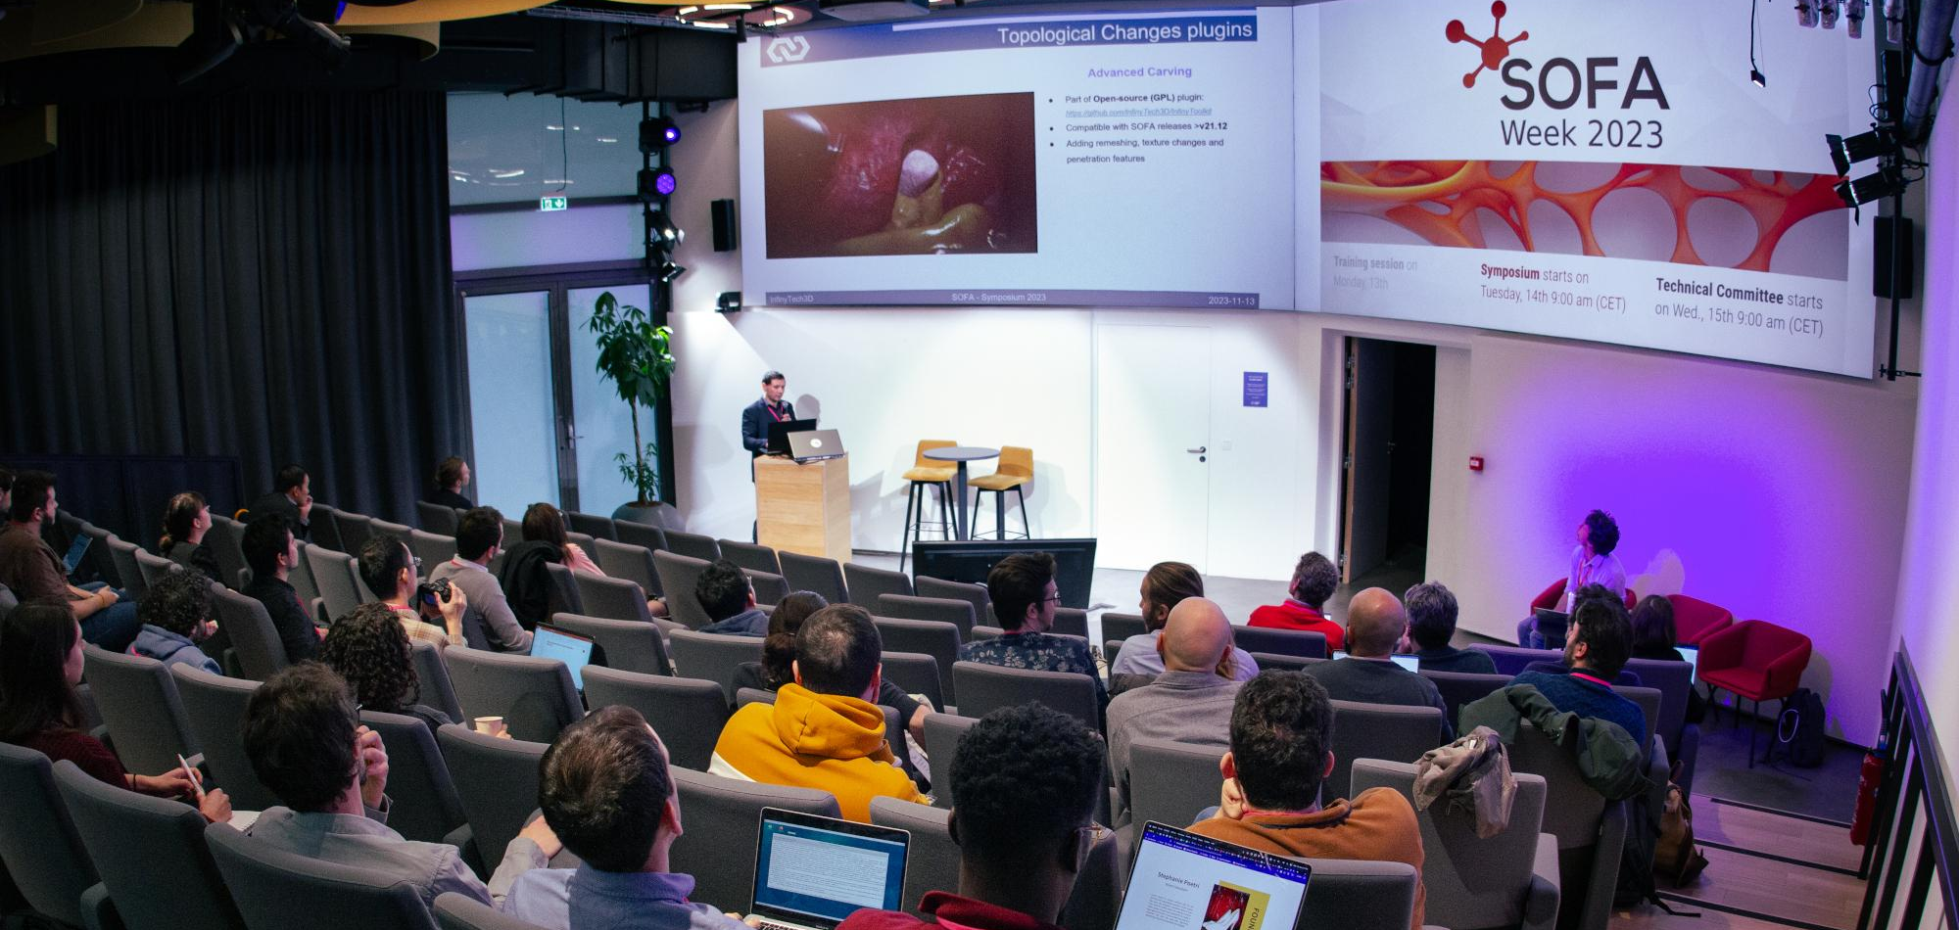
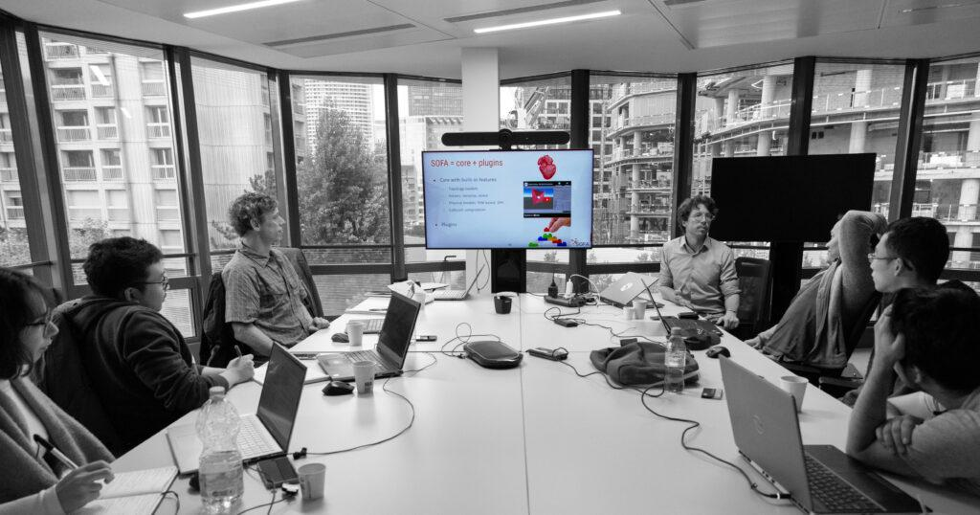
Let’s meet: SOFA Week 2025
In France (Lille) on November 24-28th
Discover the latest technological advances
Meet and networking within the community
Program
Training session - 24th Nov
SOFA Conference - 25th Nov
Technical Committee - 26-28th Nov

Slide 10

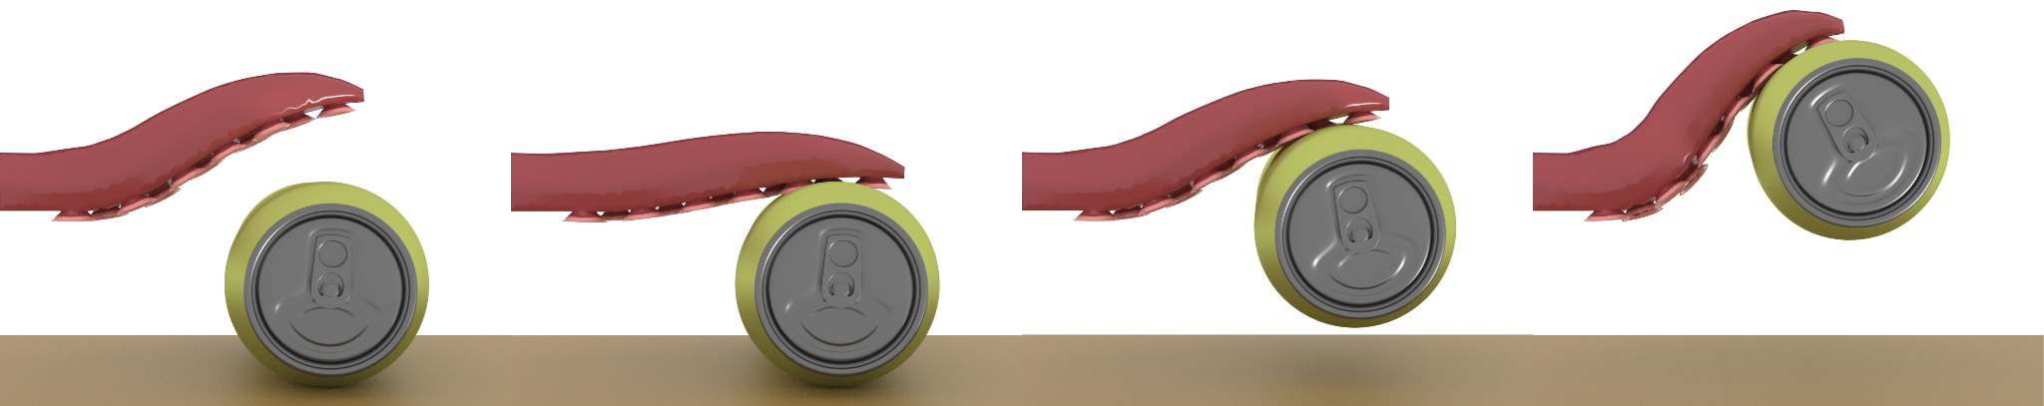
Thank you!
Discover SOFA, join the community and benefit from it!
Meet us again at our 2025 events
Any question? Web www.sofa-framework.org Contact consortium@sofa-framework.org

